Slide 1
1/30 Class 3 – Modeling, Fuzzy Matching
What is a model
Reject inference
Fuzzy matching
Scaling variables and scores

Slide 2



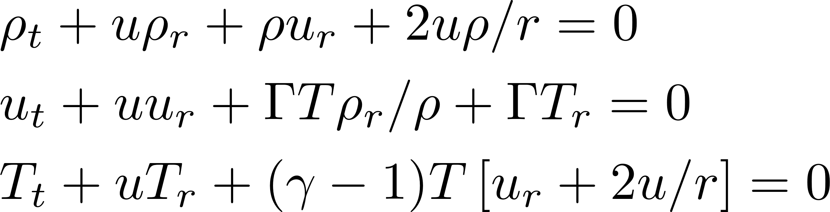


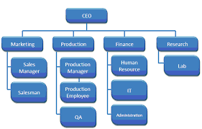
What is a Model?
A model is a representation of something
Could be first principles equations
Fundamental understanding of system dynamics
Could be simulations, rule systems
Amount of data examples
Could be a statistical model, “learned” from data examples

Slide 3
Why Do We Use Models
A Model is a representation of something. It always leaves out many details and focuses on the main factors important for the particular purpose.
We use models to get a better understanding of the world. They enable extensions of our current knowledge that we can test and use.
“All models are wrong. Some are useful.” (1978) George Box, statistician, inventor of many things including ARIMA time series models.

Slide 4
What is a Statistical Model?
A statistical model is a functional relationship, y = f(x), between a bunch of inputs and an output, where this relationship is approximated from discrete data points that have been collected
Examples:
Will this person pay back a loan? (credit score)
Is this healthcare claim a fraud?
Will John buy this product if I offer it to him?
Where will the stock market be in a month?
A statistical model is built (trained) by “showing” it a data set of past examples

Slide 5
What is a Statistical Model
The model is an explicit mathematical relationship y=f(x) between many inputs and (usually) one output
There are free parameters that are adjusted during the model training process according to a set of learning rules
The model will predict something based on some set of inputs
We can write a mathematical expression for this: y = f(x,a)
Likelihood of fraud
Credit risk
Likelihood of responding
…
y
Variables x built from the data fields
x₁, x₂, x₃, x₄, …
The f is a mathematical function that maps the inputs to the output
y is what we are trying to predict:
the model output or target
The a’s are a set of adjustable parameters set during the model training process
The x’s are the inputs or variables in the models

Slide 6
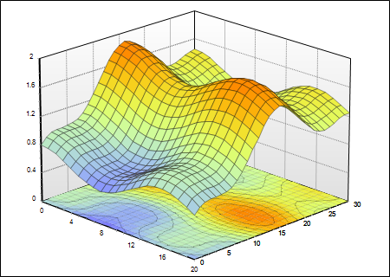
What Does a Model Look Like?
The surface is y=f(x)
Look at max, min, mean, sd’s, distributions, do normalizations
y
x₁ x₂ x₃ … x_{n} y
x₁ x₂ x₃ … x_{n} y
Many
millions
x₁ x₂ x₃ … x_{n} y
x₁ x₂ x₃ … x_{n} y
x₁ x₂ x₃ … x_{n} y
…
x₂
x₁
Many hundreds
Think this way for data preparation, statistical analysis, normalization, standardization…
Think this way for model building process, algorithm design and selection
Building a machine learning model means fitting a best surface through the data points. This is the pretty much all we do when we build a model
The art of model building is finding this “best” surface

Slide 7
How To Approach Numeric Data
n+1 columns
x1 x2 x3 …. xn y
x1 x2 x3 …. xn y
x1 x2 x3 …. xn y
…
x1 x2 x3 …. xn y
n independent variables (x’s)
One dependent variable (y)
Many more rows than columns (m >> n)
The goal is y=f(x)
m rows
x1 x2 x3 …. xn
x1 x2 x3 …. xn
x1 x2 x3 …. xn
…
x1 x2 x3 …. xn
1) Look at columns, calculate
% populated
Min, max
Mean, standard deviation
Distribution
2) Calculate covariance and correlation matrices
Shows linear relationships among variables
First step in building linear models
X =
y
y
y
…
y
Y =

Slide 8
What Does a Model Look Like? – Linear Regression
One of the simplest yet most common models is a linear regression:
y = a₁ * x₁ + a₂ * x₂ + … + a_{n} * x_{n}
The x’s are variables, the a’s are model parameters (numbers set during the model building process), and y is the model output (score)
Simple example:
x₁ = # times credit card account seen in past 3 days, x₂ = # times merchant seen in past week
Fraud score = 138 * x₁ + 226 * x₂ This is a Simple Model
These numbers, the model parameters, are set during the model building process

Slide 9
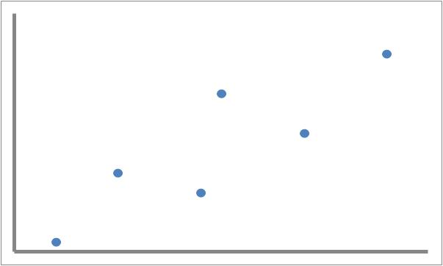
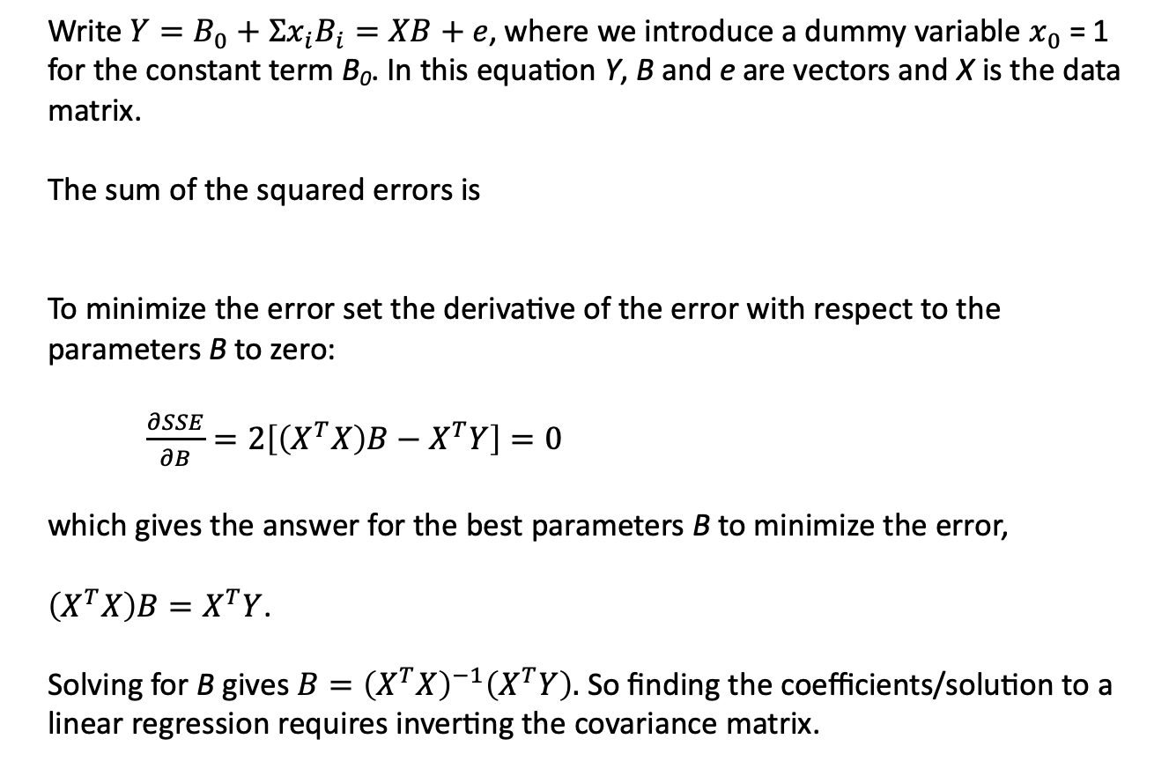
Linear Regression: a Simple but Common Model
Write$Y=B_{0}+Σx_{i}B_{i}=XB+e$, where we introduce a dummy variable $x_{0}$ = 1 for the constant term B₀. In this equation Y, B and e are vectors and X is the data matrix.
The sum of the squared errors is
To minimize the error set the derivative of the error with respect to the parameters B to zero:
$\frac{∂SSE}{∂B}=2\left[\left(X^{T}X\right)B−X^{T}Y\right]=0$
which gives the answer for the best parameters B to minimize the error,
$\left(X^{T}X\right)B=X^{T}Y$.
Solving for B gives $B={\left(X^{T}X\right)}^{−1}\left(X^{T}Y\right).$ So finding the coefficients/solution to a linear regression requires inverting the covariance matrix.

Slide 10

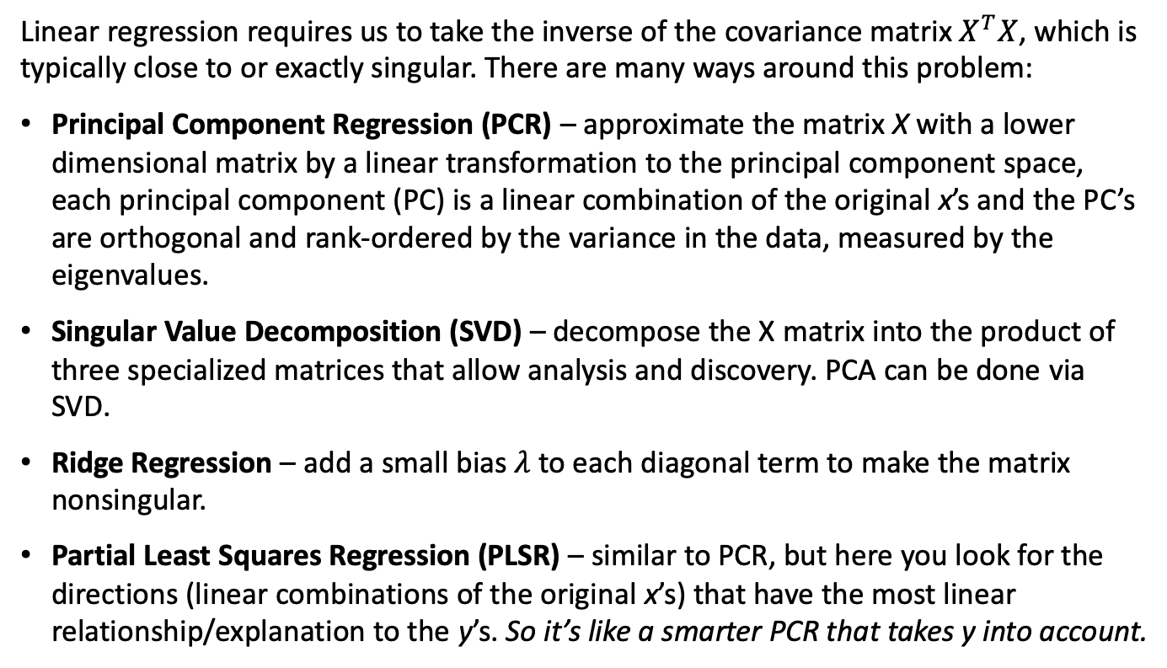
Linear Regressions Require Matrix Inversion
$B={\left(X^{T}X\right)}^{−1}\left(X^{T}Y\right).$
Linear regression requires us to take the inverse of the covariance matrix $X^{T}X$, which is typically close to or exactly singular. There are many ways around this problem:
Principal Component Regression (PCR) – approximate the matrix X with a lower dimensional matrix by a linear transformation to the principal component space, each principal component (PC) is a linear combination of the original x’s and the PC’s are orthogonal and rank-ordered by the variance in the data, measured by the eigenvalues.
Singular Value Decomposition (SVD) – decompose the X matrix into the product of three specialized matrices that allow analysis and discovery. PCA can be done via SVD.
Ridge Regression – add a small bias $λ$to each diagonal term to make the matrix nonsingular.
Partial Least Squares Regression (PLSR) – similar to PCR, but here you look for the directions (linear combinations of the original x’s) that have the most linear relationship/explanation to the y’s. So it’s like a smarter PCR that takes y into account.

Slide 11
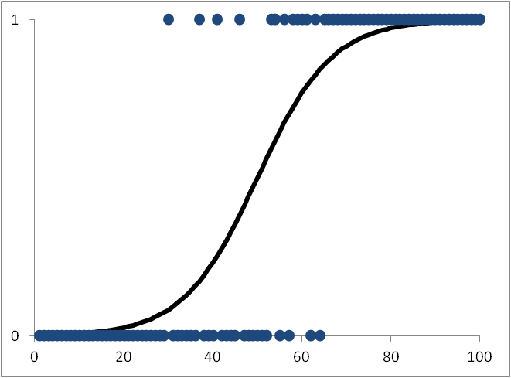
For Binary Output Models, Logistic Regression is Better
Use this for continuous outputs:
Linear Regression
y
probability of fraud
Fraction of “1”s at that score
Use this for binary outputs:
Logistic Regression
Score
A linear regression is appropriate when the output y has a continuous range.
For classification problems where the output y takes one of two values (e.g., good/bad), the output of the model y is the probability that it takes a particular value. Since the output y only ranges from zero to one, a logistic regression is more appropriate. The logit function “squashes” the linear regression function at high and low values, restricting it to between 0 and 1.
Almost all models used in business are either linear or logistic regressions!

Slide 12
There are Many Methods for Statistical Models
Statistics community:
Linear, logistic regressions
PCR, PLS
Factor analysis
ARIMA, GARCH forecasting
Machine learning community
Decision trees
Neural nets
SVM
Nearest neighbor
Clustering
Generally show all the data at once
Generally linear
Generally learn incrementally, point by point
Generally nonlinear
…
Boosted trees
Random forests
Bayesian networks
Deep learning
Convolutional neural nets
…

Slide 13
Process for Product Applications, Transactions, Claims…
Through
The Door
(TTD)
Credit check,
eligibility
(score, algorithm)
Yes/OK
Fraud check
(score, algorithm)
Yes/OK
Approve
Book new account,
Pay claim or request
Approve transaction
…
No
No
FRAUD EXPERTS,
EXAMINERS
Decline
Manually review
Get external data
Make phone call
Send letter, email
…
Review
Yes/OK
Approve
Outcome generally known
Label as a good or bad
No
Decline
Note: “algorithm” can be rules, linear or logistic regression, or complex ML model
Don’t know truth
(leads to Reject Inference problem)
This process is used for any product that pays money (loans, credit cards, cell phones, insurance claims…)
13

Slide 14
Risk Management Rate Metrics
All Population
Yes/OK
Book new account,
Pay claim or request
Approve transaction
…
Good
Risk Models
N_{G}
N_{in}
Approve
No
N_{A}
Bad
N_{B}
Decline
Fraud
N_{D}
N_{F}
Typical values
(depend on process, product)
Approval rate = N_{A} / N_{in}
Decline rate = N_{D} / N_{in}
Bad rate = N_{B} / N_{A}
Fraud rate = N_{F} / N_{A}
50 – 80%
20 – 50%
4 – 10%
.1 – 2%
14

Slide 15
Analysis for Loan/Credit Card Applications
All applications
Book
Accepts: Look at
Overall bad rate (# bads / # booked)
Bad rate by
Credit class
Geography
Demographics
Application month (vintage)
…
Risk management scores (credit, fraud)
Yes
No
Decline
Declines: Look at
Decline rate (# declined / # applied)
Decline rate by
Credit class
Geography
Demographics
Application month (vintage)
…
15

Slide 16
Reject Inference Process: M₀, M₁, M₁’
All Population
Yes/OK
Risk Model M₀
Approve
No
Book new account,
Pay claim or request
Approve transaction
…
Outcome generally known
Label as a good or bad
Decline
Don’t know truth
(leads to Reject Inference problem)
16

Slide 17
What Do We Do When We Build A Model?
Given a bunch of historical data with labels
x2
for example, overall debt
For example, # times delinquent in the past
x1
Consider two independent variables x1, x2, one binary dependent variable (good, bad)

Slide 18
Use Historical Data to Build Model M₀
The model is y = f(x)
high
Model M₀ score
The score direction is a straight line for linear models (lin, log reg), but can be more general with nonlinear models
x2
low
x1

Slide 19
The Model Score Defines Levels Of Badness
high
Model M₀ score
x2
very bad
bad
low
somewhat bad
somewhat good
good
very good
x1

Slide 20
We Decide a location for a Score Cutoff
high
Model M₀ score
x2
very bad
low
Score cutoff
very good
x1

Slide 21
The Score and Cutoff Define Decision Regions
Reject
Accept
x2
Model M₀
Score cutoff
x1

Slide 22
We Use Model M₀ for a Few Years
All Population
Yes/OK
Risk Model M₀
Approve
No
Book new account,
Pay claim or request
Approve transaction
…
Outcome generally known
Label as a good or bad
Decline
Don’t know truth
(leads to Reject Inference problem)
After a few years we have enough data to build a new model M₁

Slide 23
Now We Have New Data, But in a Biased Region
Accept
Model M₀
Reject
We have data in this region, but they were rejected so we have no labels
x2
We only accepted events in this region, so we only have labeled data in this region. We build our new model M1 using the only labeled data we have.
Score cutoff
x1

Slide 24
Our Data For Building M₁ Looks Like This
Accepts
Rejects
x2
Model M₀ Score cutoff
x1
We only have data with labels in this biased region. We build our new model M1 using the only labeled data we have.

Slide 25
The New Model M₁ is Generally Different From M₀
The red points are ones where the old model M₀ made a mistake
high
x2
Model M₁ Score cutoff
low
Model M₀ Score cutoff
x1
Consumer behavior has changed a bit and the new model M₁ is somewhat different from the old model M₀

Slide 26
We Use the Predictions of M₁ to Label the Unknown Data Points
Use M₁ to infer the labels on the rejects
x2
Model M₁ Score cutoff
Model M₀ Score cutoff
x1

Slide 27
Now We Rebuild M1 Using All the Data
We add the rejects with their inferred labels to the data set and rebuild to get a final model M₁’, which is only slightly different from M₁
The different tilt of M₁’ from M₁ is due only to the locations of the inferred rejects
x2
Model M₁’ Score cutoff
Model M₁ Score cutoff
x1

Slide 28
Summary of Reject Inference Process
Implemented model M₀ decides accepts and rejects
When ready to build a new model we only have labels on the accepts
Use the labeled accepts to build the next model M₁
Use M₁ to predict/infer the labels of the rejects (reject inference)
Add these now-labeled rejects points and rebuild to get M₁’, which is slightly different from M₁.

Slide 29
What’s Going On in Reject Inference?
M₀ is a “filter” that only allows certain data to be labeled.
The labels for this data come from actual performance. Note that M₀ makes some mistakes.
Build M₁ using this labeled data.
Use M₁ to “make” new data: the rejects.
Rebuild M₁ with this new data to get M₁’.
We used M₁ to make new data to rebuild M₁. This is circular reasoning. No new information was added.
The difference between M₁ and M₁’ is due only to the particular location of the inferred rejects.

Slide 30
Fuzzy Matching Algorithms
2) Match columns:
Are these two field values the same for all records?
x1 x2 x3 …. xn y
x1 x2 x3 …. xn y
x1 x2 x3 …. xn y
…
x1 x2 x3 …. xn y
1) Match field values:
Are these two particular field values the same for these two records?
3) Match records:
How close are these two record’s values?

Slide 31
Some Fuzzy Matching Algorithms for Individual Field Values
Levenshtein edit distance – minimum # single character edits (insertions, deletions, substitutions)
Damerau-Levenshtein – Levenshtein plus transpositions
Jaro-Winkler: # single adjacent character transpositions
Hamming – % characters that are different (substitutions only)
Other variations
N grams – a sliding window of n characters. Can count how many are the same between two fields.
Soundex – a phonetic “sounds like” comparison (John, Djahn)
Frequently need to do stemming, root match – determine the root of the word and compare by roots
Field specific, ad hoc heuristic

Slide 32
Levenshtein Edit and N Grams
Compare: ‘string1’ to ‘dtring2’
Levenshtein distance is 2:
’s’ to ‘d’
‘1’ to ‘2’
Trigrams: make a 3-character sliding window, move across both strings, make a list of all trigrams: str, tri, rin, ing, ng1, dtr, ng2
Then can use one of many ways to compare. A common one is Jaccard – fraction of elements that are the same, in this case, 3/7
Works fairly well with longer fields

Slide 33
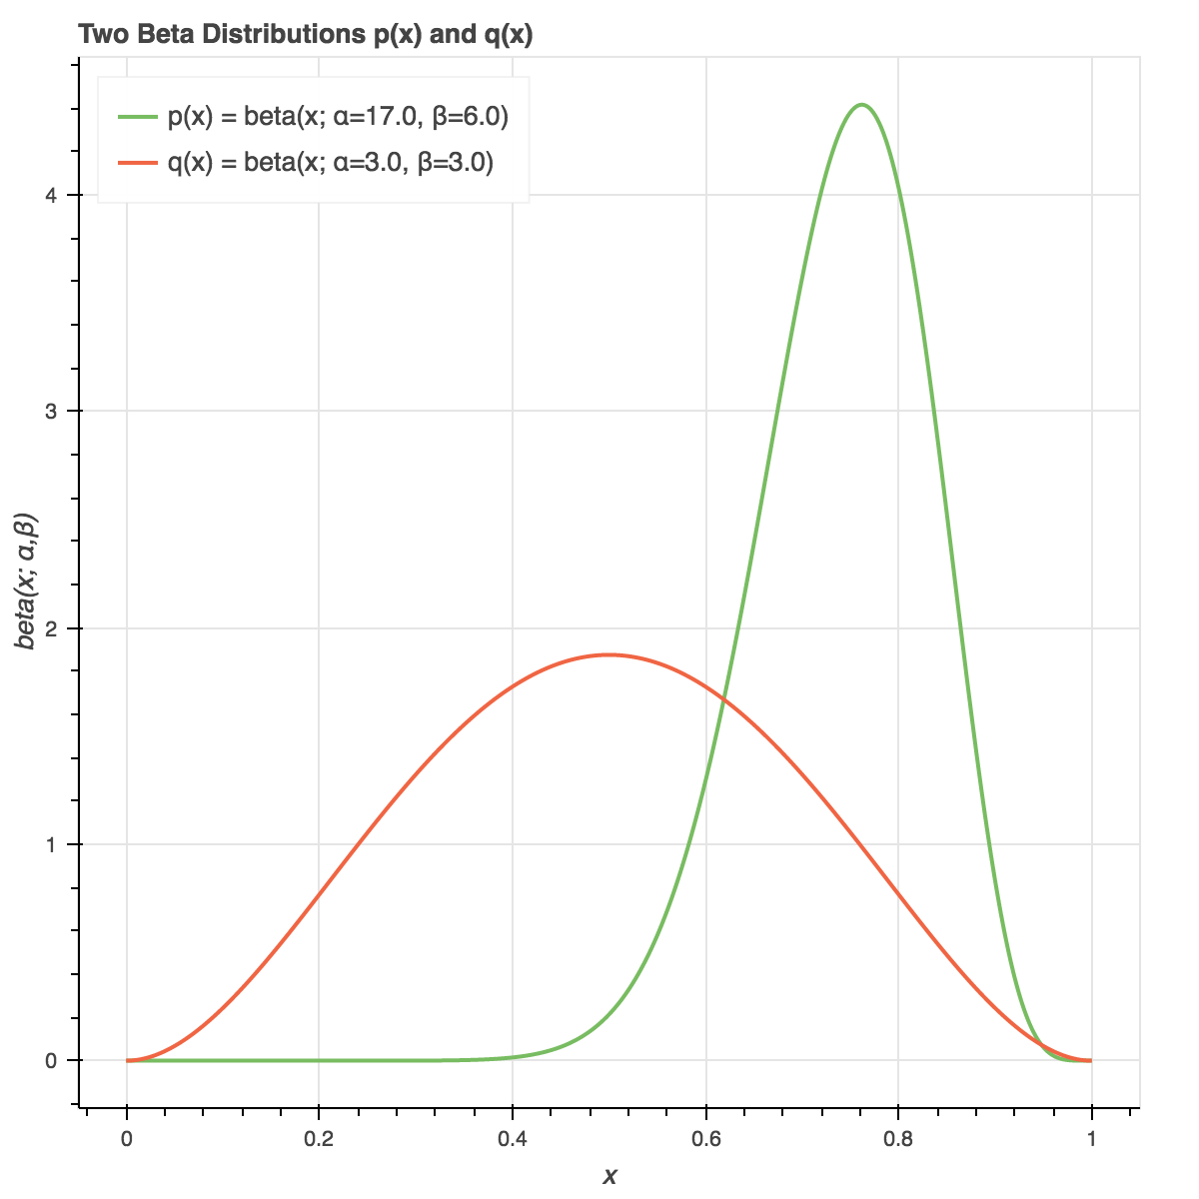
Some Fuzzy Matching Algorithms for Columns
Examine individual values:
Linear correlation (Pearson correlations)
Examine the two column distributions:
Fisher Score (scaled separation of means)
Kolmogorov-Smirnov distance (KS)
Kulback-Leibler/Information Value distance (IV)
Column i
Column j

Slide 34
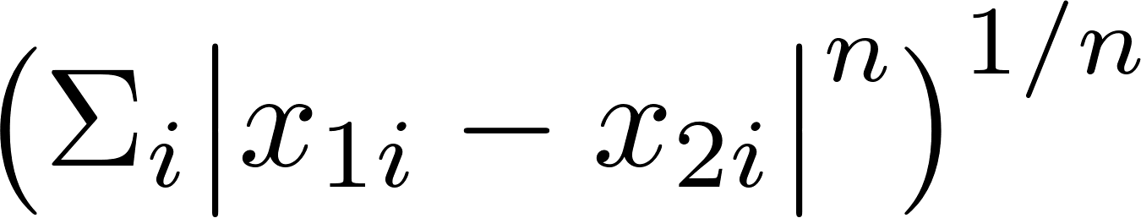
Some Multidimensional Distance Metrics to Match Records
How close are these data points/records?
x₃
x₁
x₂
x₂
x₁
Mahalanobis: rotation, z scaling then Eucledian
A popular formula is Minkowski, D=
Euclidean, n=2 (L2)
Manhattan, n=1 (L1): distance traversed along axes
Chebyshev, n very large (L-infinity): max along any axis
Only use any of the Minkowski distances after proper scaling
dimensions

Slide 35
Different Choices of n Give Different Distance Measures
dimensions
x
n=0: D= Not defined and not useful
n=1: D= Manhattan distance
n=2: D= Eucledian
n=10: D= Selects the maximum x_{i}
n=-10: D= Selects the minimum x_{i}
Consider distance to origin: D=
x₃
x₁
x₂
Most common choice:
n = 1 or 2
(Chebyshev)
The higher the choice of n the more the distance measure focuses on the largest dimension value

Slide 36
Generalized Distance Measures Between Vectors
Minkowski:
Mahalanobis:
Dot product:
Kernel
n=2 is Eucledean:
Covariance matrix
for unit vectors
Traditional:
Polynomial:
Gaussian radial basis:
Hyperbolic tangent:
…

Slide 37
Ad Hoc Fuzzy Matching Algorithms
Some fields have idiosyncrasies that require deep understanding before building a fuzzy matching algorithm
Examples:
Birthdate: 03241987, 19870324, 03-24-1987
SSN: 123456789
phone number: 123-456-7890
credit card numbers: 5425287428753847
Really hard fields: name, addresses
month
day
year
state
time
sequential
area code
exchange
number
Bank identification number
Industry identifier
account
check sum

Slide 38
Find Records For a Thomas Williams
The FBI came to our NY organization and asked for help. They got a tip that someone named Thomas Williams is involved in some criminal activity.
They want us to find all the property records in our data that are associated with a person named Thomas Williams.

Slide 39
Homework 3 – Find the Thomas Williams
In the NY property data, which records have as an owner a person named Thomas Williams?
Submit a list with the count and all the records you find (record #, name, count, sorted by record #)
Grading
N_{student} = # correct - # wrong
% student = N_{student} / N_{my answer}
% student points
100%
15
>95%
14
>90%
13
Example showing the format
>85%
12
>80%
10
…
>75%
9

Slide 40
Break

Slide 41
Two Ways to Scale Variables/Scores
Frequently we need to put multiple variables or scores on the same footing (scale) so we can combine or otherwise use them (e.g., as inputs to models, combine scores in ensemble models)
This is a must-do for any clustering algorithm
Z scaling is very popular and useful but is not best for combining highly skewed distributions, particularly in combining scores
Quantile binning is an alternative and robust method
We typically use z scaling to scale variables and quantile binning to combine scores

Slide 42
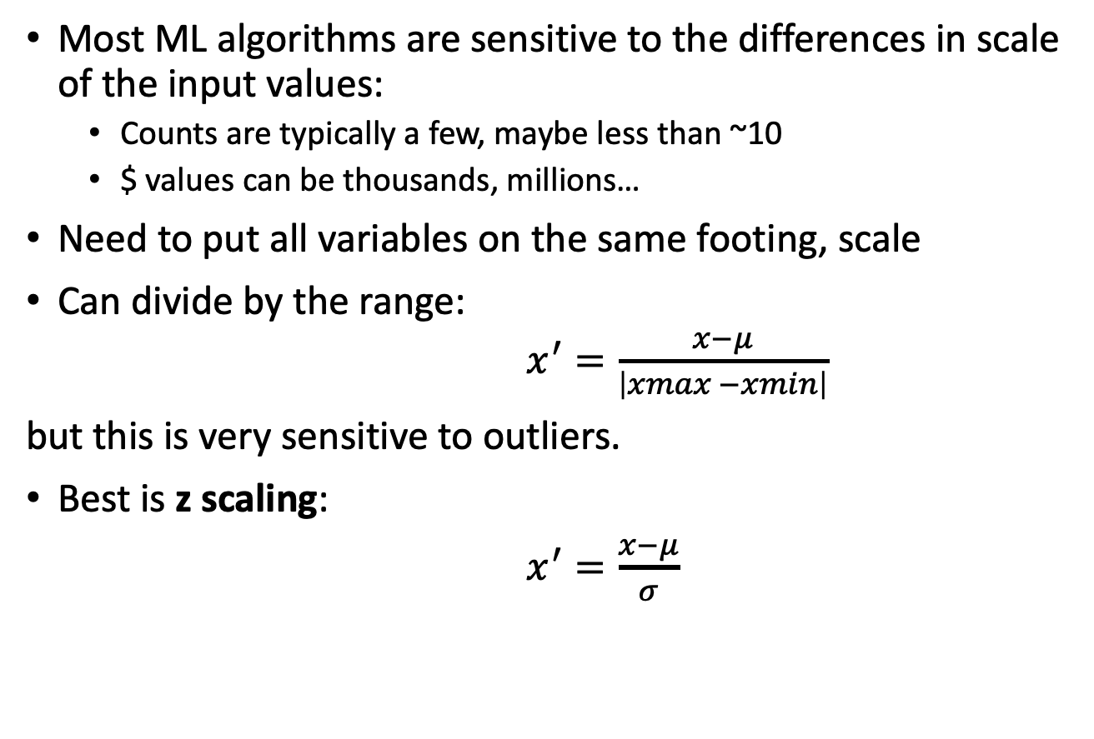
How To Scale Data
Most ML algorithms are sensitive to the differences in scale of the input values:
Counts are typically a few, maybe less than ~10
$ values can be thousands, millions…
Need to put all variables on the same footing, scale
Can divide by the range:
$x^{′}=\frac{x−μ}{\left|xmax −xmin\right|}$
but this is very sensitive to outliers.
Best is z scaling:
$x^{′}=\frac{x−μ}{σ}$
Don’t do this
Do this

Slide 43
Another Way To Scale: Quantile Binning
The idea is that we transform a variable or score into it’s quantile rankings. This is used frequently when we want to scale the outputs from several models so we can combine them.
Bin the data into bins of equal population but unequal width
Replace the original values (variable or score) with the bin #
Now all the variables/scores are on equal scales
It’s best to use a fairly large number of bins, like 1000
Can also simply replace the score with the record’s rank order after sorting by the score. This is the same as # bins = # records
data distribution
For example, 20 bins:
Number the bins
5%
5%
5%
5%
5%
1
3
…
14
16
17
18
19
20
2
15
Typically best

Slide 44
Quantile Binning: Replace Variable or Score With Sorted Bin Number
Sort records by the variable or score you want to scale. Bin the records into equal count bins. Replace the variable or score with the record’s bin number.
Scale a variable x_{i}:
Replace the values in column x_{i} with the record’s bin #:
x_{i} -> x_{i}’ = 1, 2, 3,…
Want to scale column x_{i}
Sort records by the value in column x_{i}
low
Bin into equal # records/bin
1
Bin 1
1
Data sorted by column x_{i}.
Note – the records are all now in a different order from before
1
1
2
Bin 2
2
Original data
2
2
3
Bin 3
3
3
3
4
Bin 4
4
4
…
4
5
high
5

Slide 45
Extreme Quantile Binning: Replace Variable or Score With Record Rank Order
Replace the variable or score with the record’s rank order after sorting by the column. This is the same as # bins = # records.
Scale a variable x_{i}:
Replace the values in column x_{i} with the record’s rank order:
x_{i} -> x_{i}’ = 1, 2, 3,…
Want to scale column x_{i}
Sort records by the value in column x_{i}
low
1
2
3
4
5
Data sorted by column x_{i}
6
Original data
7
8
9
10
11
12
…
high
This is a very good method to use to scale scores before combining/averaging them

Slide 46
Common to Use Rank Order When Combining Scores
Do the rank order replacement for each score separately. Then each score is on the same footing and can be combined however you like (weighted average, max, min…)
Each record has two scores appended, s₁ and s₂
Sort the records by s₁, low to high
Replace s₁ with s₁’, the s₁-sorted rank order
Sort the records by s₂, low to high
Replace s₂ with s₂’, the s₂-sorted rank order
Now s₁’ and s₂’ are on the same scale and can be combined

Slide 47
Project 1 Report Outline
Cover Page: Title, project team names, date.
Table of Contents.
Executive Summary: (few paragraphs) high level summary of project and results.
Description of Data: (few pages) text description of the data, summary table of field statistics, a few of the most important distributions/histograms, put the full DQR in appendix).
Data Cleaning: (one or a few pages). How did you fill in missing fields.
Variable Creation: (few pages) describe in complete detail the formulas and logic for creating all the model variables. Include a list of all variables.
Dimensionality Reduction: How and why you scaled and reduced the variables.
Algorithms: (one or a few pages) Completely describe the way the two fraud scores are calculated. Give text explanation of why each method is a reasonable fraud score/anomaly detector. Describe how you combine the two scores to get the final score.
Results: (few pages) Plot the three fraud score distributions (s₁, s₂, final score). Show the top 10 records and describe why they look anomalous. Make sure all examples are unusual in some way, even if they have a good explanation.
Conclusions: Few paragraphs summarizing everything you did and what else you might do with more time.
Appendix: DQR

Slide 48
Project 1 High-Level Plan
We are looking for unusual valuations on the fields FULLVAL, AVLAND and AVTOT
We build special variables to as best as possible represent these value fields to look for anomalies
We normalize by lot area, building area, and building volume, grouped by 5 different entities
After creating the variables we remove correlations and reduce dimensions
We apply two outlier detection methods and combine the results for a final anomaly score

Slide 49
Steps to Build an Unsupervised Fraud Model
Build special variables that look for the fraud mode, some variables using entities and groupings, as many meaningful variables as possible
Scale and minimize dimensionality
Z scale
PCA, keep top ~5 to 10 PCs; look at the eigenvalues and keep maybe up to 80%.
Represent each record in this new reduced space of the PCs
Z scale the data fields again (we can call these zscores)
Score 1: Combine the zscores with a heuristic algorithm:
sum of absolute zscores, zscores squared, max/mins, weighted sum of zscores…
Score 2: Autoencoder on the z scaled PCs, and the fraud score is the reconstruction error
Use quantile binning/rank ordering to scale each score
Final fraud score is a combination of these two scaled scores

Slide 50
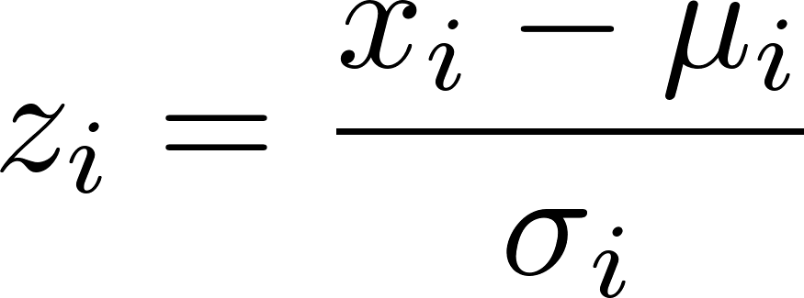
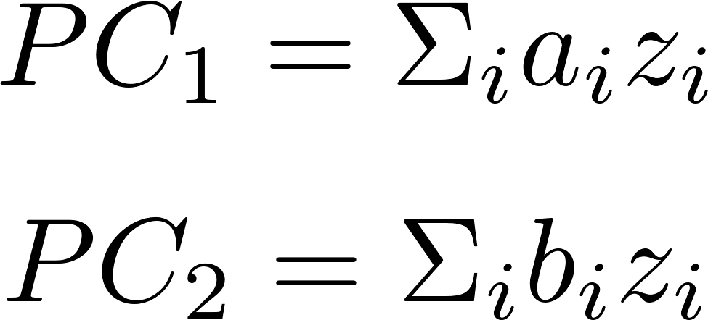
Unsupervised Fraud Algorithm
Build many expert variables that quantify signals for various fraud modes
Z scale to prepare for dimensionality reduction
Reduce dimensions via PCA, throw away all but top few PCs
~10¹
~10²
Original
data
Feature engineering
Expert
variables
(x’s)
~10⁶
~10⁶
~10²
~10²
x₁ …. x_{n}
x₁ …. x_{n}
Scaling
z₁ …. z_{n}
z₁ …. z_{n}
~10⁶
…
…
~10⁶
…
…
~10²
~10¹
z₁ …. z_{n}
z₁ …. z_{n}
Dimensionality
reduction
PC₁ …. PC_{n}
PC₁ …. PC_{n}
~10⁶
…
…
~10⁶
…
…
…

Slide 51
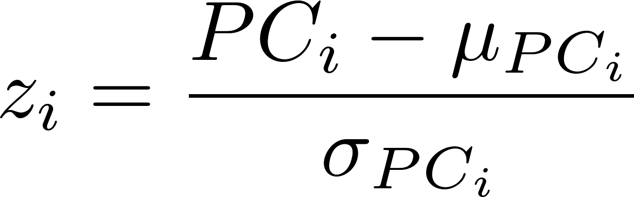
Unsupervised Fraud Algorithm continued
Z scale the reduced variables (the PC’s)
Score 1: The fraud score is any function of these zscores that looks for extremes:
~10¹
~10¹
PC₁ …. PC_{n}
PC₁ …. PC_{n}
z₁ …. z_{n}
z₁ …. z_{n}
~10⁶
Scaling
…
…
~10⁶
…
…
These are different z’s from the previous page
Score 2: (a) train an autoencoder on all the data to reproduce the z scaled PC records, then (b) the fraud score is any measure of difference between the original input record and the autoencoder output record, for example
Combine the two scores using weighted average rank orders to get the final score
6.
7.
Note that these score formulas are identical. The first finds the distance from the origin.

